Slide 1
“THEORY OF AUTOMATA”
Kleene’s Theorem

Slide 2
Summary
Examples of GTG accepting the languages of strings: containing aa or bb, beginning with and ending in same letters, beginning with and ending in different letters, containing aaa or bbb,
Nondeterminism, Kleene’s theorem (part I, part II, part III), proof of Kleene’s theorem part I
Examples of writing REs to the corresponding TGs, RE corresponding to TG accepting EVEN-EVEN language,
Kleene’s theorem part III (method 1:union of FAs), examples of FAs corresponding to simple REs, example of Kleene’s theorem part III (method 1) continued

Slide 3

Examples of GTG accepting the languages of strings: containing aa or bb
Example
Consider the language L of strings, defined over Σ = {a,b}, containing double a or double b. The language L can be expressed by the following regular expression (a+b)* (aa + bb) (a+b)*
The language L may be accepted by the following GTG.

Slide 4
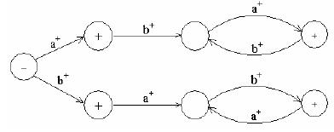
Beginning with and ending in same letters
Example
Consider the Language L of strings, defined overΣ= {a, b}, beginning with and ending in same letters. The language L may be expressed by the following regular expression (a+b)+ a(a + b)*a + b(a + b)*b. This language may be accepted by the following GTG

Slide 5
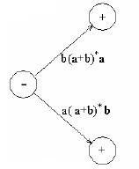
Beginning with and ending in different letters
Example
Consider the language L of strings of, defined over Σ = {a, b}, beginning and ending in different letters. The language L may be expressed by RE a(a + b)*b + b(a + b)*a The language L may be accepted by the following GTG

Slide 6
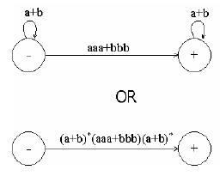
Containing aaa or bbb
Example
Consider the language L of strings, defined over Σ = {a, b}, having triple a or triple b. The language L may be expressed by
RE (a+b)* (aaa + bbb) (a+b)* This language may be accepted by the following GTG

Slide 7
Nondeterminism
TGs and GTGs provide certain relaxations i.e. there may exist more than one path for a certain string or there may not be any path for a certain string, this property creates nondeterminism and it can also help in differentiating TGs or GTGs from FAs. Hence an FA is also called a Deterministic Finite Automaton (DFA).

Slide 8
Kleene’s Theorem
If a language can be expressed by
FA or
TG or
RE
then it can also be expressed by other two as well.
It may be noted that the theorem is proved, proving the following three parts

Slide 9
Kleene’s Theorem Part I
If a language can be accepted by an FA then it can be accepted by a TG as well.
Kleene’s Theorem Part II
If a language can be accepted by a TG then it can be expressed by an RE as well.
Kleene’s Theorem Part III
If a language can be expressed by a RE then it can be accepted by an FA as well.
Proof(Kleene’s Theorem Part I)
Since every FA can be considered to be a TG as well, therefore there is nothing to prove.

Slide 10
Proof(Kleene’s Theorem Part II)
To prove part II of the theorem, an algorithm consisting of different steps, is explained showing how a RE can be obtained corresponding to the given TG. For this purpose the notion of TG is changed to that of GTG i.e. the labels of transitions are corresponding REs.
Basically this algorithm converts the given TG to GTG with one initial state along with a single loop, or one initial state connected with one final state by a single transition edge. The label of the loop or the transition edge will be the required RE.

Slide 11
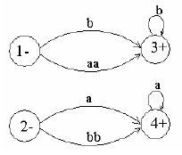
Step 1
If a TG has more than one start states, then introduce a new start state connecting the new state to the oldstart states by the transitions labeled by K and make the old start states the non-start states. This step can be shown by the following example

Slide 12
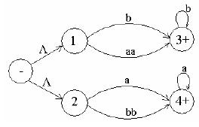
Step 2:
If a TG has more than one final states, then introduce a new final state, connecting the old final states to the new final state by the transitions labeled by K. This step can be shown by the previous example of TG, where the step 1 has already been processed

Slide 13
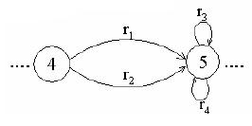
Step 3:
If a state has two (more than one) incoming transition edges labeled by the corresponding REs, from the same state (including the possibility of loops at a state), then replace all these transition edges with a single transition edge labeled by the sum of corresponding REs. This step can be shown by a part of TG in the following example

Slide 14
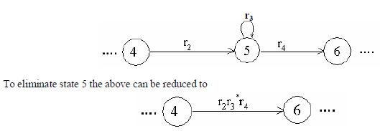
Step 4 (bypass and state elimination)
If three states in a TG, are connected in sequence then eliminate the middle state and connect the first state with the third by a single transition (include the possibility of circuit as well) labeled by the RE which is the concatenation of corresponding two REs in the existing sequence. This step can be shown by a part of TG in the
following example

Slide 15
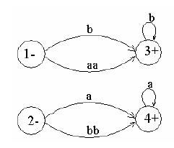
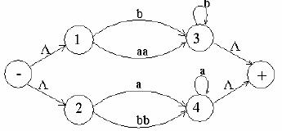
Example
Consider the following TG
To have single initial and single final state the above TG can be reduced to the following

Slide 16
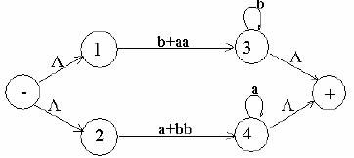
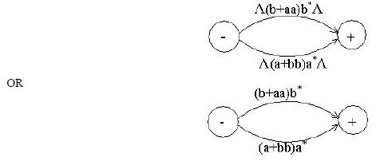
To obtain single transition edge between 1 and 3; 2 and 4, the above can be reduced to the following
To eliminate states 1,2,3 and 4, the above TG can be reduced to the following TG

Slide 17
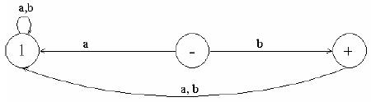
Kleene’s Theorem Part III
Statement:
If the language can be expressed by a RE then there exists an FA accepting the language. As the regular expression is obtained applying addition, concatenation and closure on the letters of an alphabet and the Null string, so while building the RE, sometimes, the corresponding FA may be built easily, as shown in the following examples
Example
Consider the language, defined overΣ= {a,b}, consisting of only b, then this language may be accepted by the following FA

Slide 18

Example
Consider the language, defined over Σ = {a,b}, consisting of only Λ, then this language may be accepted by the following FA
As, if r₁ and r₂ are regular expressions then their sum, concatenation and closure are also regular expressions, so an FA can be built for any regular expression if the methods can be developed for building the Fas corresponding to the sum, concatenation and closure of the regular expressions along with their FAs. These three methods are explained in the following discussion

Slide 19
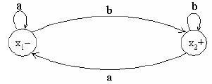

Method1 (Union of two FAs)
Using the FAs corresponding to r₁ and r₂ an FA can be built, corresponding to r₁+ r₂. This method can be developed considering the following examples
Example
Let r₁ = (a+b)*b defines L₁ and the FA₁ be
and r₂ = (a+b )*aa(a+b )* defines L₂ and FA₂ be

Slide 20
Let FA₃ be an FA corresponding to r₁+ r₂, then the initial state of FA₃ must correspond to the initial state of FA₁ or the initial state of FA₂. Since the language corresponding to r₁+ r₂ is the union of corresponding languages L₁ and L₂, consists of the strings belonging to L₁or L₂ or both, therefore a final state of FA₃ must correspond to a final state of FA₁ or FA₂ or both. Since, in general, FA₃ will be different from both FA₁ and FA₂, so the labels of the states of FA₃ may be supposed to be z₁,z₂, z₃, …, where z₁ is supposed to be the initial state. Since z₁ corresponds to the states x₁ or y₁, so there will be two transitions separately for each letter read at z₁. It will give two possibilities of states either z₁ or different from z₁. This process may be expressed in the following transition table for all possible states of FA₃.

Slide 21
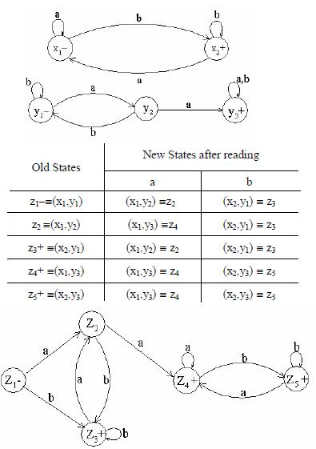
RE corresponding to the above FA may be
r₁+r₂ = (a+b)*b + (a+b )*aa(a+b )*.

Slide 22
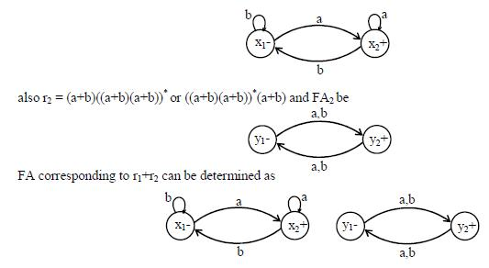
Example
Let r1 = (a+b)*a and the corresponding FA₁ be

Slide 23
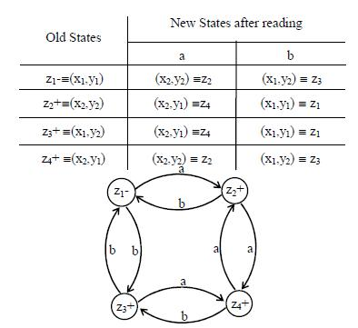

Slide 24


Method2 (Concatenation of two FAs)
Using the FAs corresponding to r₁ and r₂, an FA can be built, corresponding to r₁r₂. This method can be developed considering the following examples
Example
Let r1 = (a+b)*b defines L₁ and FA₁ be
and r2 = (a+b )*aa (a+b )* defines L₂ and FA₂ be

Slide 25
Method3: (Closure of an FA)
Building an FA corresponding to r*, using the FA corresponding to r. It is to be noted that if the given FA already accepts the language expressed by the closure of certain RE, then the given FA is the required FA. However the method, in other cases, can be developed considering the following examples Closure of an FA, is same as concatenation of an FA with itself, except that the initial state of the required FA is a final state as well. Here the initial state of given FA, corresponds to the initial state of required FA and a non final state of the required FA as well.

Slide 26

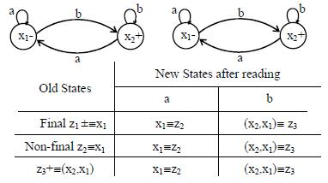
Example
Let r = (a+b)*b and the corresponding FA be
then the FA corresponding to r* may be determined as under

Slide 27
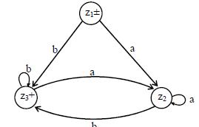
The corresponding transition diagram may be as under

Slide 28

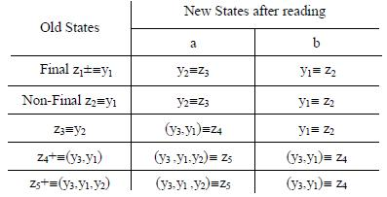
Example
Let r = (a+b)*aa(a+b)* and the corresponding FA be
then the FA corresponding to r* may be determined as under

Slide 29
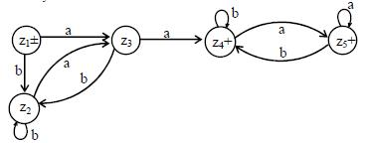
The corresponding transition diagram may be

Slide 30
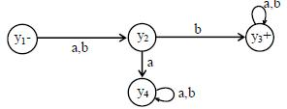
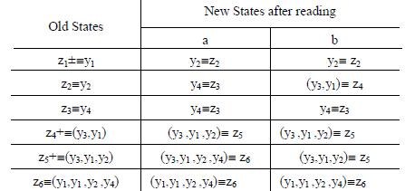
Example
Consider the following FA, accepting the language of strings with b as second letter
then the FA corresponding to r* may be determined as under

Slide 31
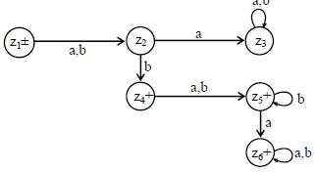
The corresponding transition diagram may be

Slide 32
Nondeterministic Finite Automaton (NFA)
Definition
An NFA is a TG with a unique start state and a property of having single letter as label of transitions. An NFA is a collection of three things
Finite many states with one initial and some final states
Finite set of input letters, say, Σ = {a, b, c}
Finite set of transitions, showing where to move if a letter is input at certain state (Λ is not a valid transition),
there may be more than one transition for certain letters and there may not be any transition for certain letters

Slide 33
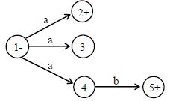
Observations
It may be observed, from the definition of NFA, that the string is supposed to be accepted, if there exists at least one successful path, otherwise rejected. It is to be noted that an NFA can be considered to be an intermediate structure between FA and TG.
The examples of NFAs can be found in the following
Example
It is to be noted that the above NFA accepts the language consisting of a and ab

Slide 34

Example
It is to be noted that the above NFA accepts the language of strings, defined over Σ = {a, b}, containing aa
Note
It is to be noted that NFA helps to eliminate a loop at certain state of an FA. This process is done converting the loop into a circuit. But during this process the FA remains no longer FA and is converted to a corresponding NFA, which is shown in the following example.

Slide 35

Converting an FA to an equivalent NFA
It is to be noted that according to the Kleene’s theorem, if a language can be accepted by an FA, then there exists a TG accepting that language. Since, an NFA is a TG as well, therefore there exists an NFA accepting the language accepted by the given FA. In this case these FA and NFA are said to be equivalent to each others. Following are the examples of FAs to be converted to the equivalent NFAs
Example
Consider the following FA corresponding to (a+b)*b
The above FA may be equivalent to the following NFA

Slide 36
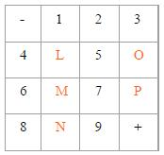
Application of an NFA
There is an important application of an NFA in artificial intelligence, which is discussed in the following
example of a maze
- and + indicate the initial and final states respectively. One can move only from a box labeled by other then L, M, N, O, P to such another box. To determine the number of ways in which one can start from the initial state and end in the final state, the following NFA using only single letter a, can help in this regard

Slide 37
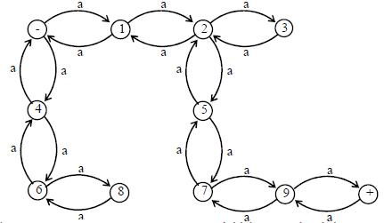
It can be observed that the shortest path which leads from the initial state and ends in the final state, consists of six steps i.e. the shortest string accepted by this machine is aaaaaa. The next larger accepted string is aaaaaaaa. This if this NFA is considered to be a TG then the corresponding regular expression may be written as
aaaaaa(aa)* Which shows that there are infinite many required ways

Slide 38
NFA with Null String
Definition
If in an NFA, Λ is allowed to be a label of an edge then the NFA is called NFA with Λ (NFA-Λ).
An NFA-Λ is a collection of three things
Finite many states with one initial and some final states.
Finite set of input letters, say, Σ = {a, b, c}.
Finite set of transitions, showing where to move if a letter is input at certain state.
There may be more than one transitions for certain letter and there may not be any transition for a certain letter. The transition of Λ is also allowed at any state.

Slide 39


Example
Consider the following NFA with Null string
The above NFA with Null string accepts the language of strings, defined over Σ = {a, b}, ending in b.
Example
Consider the following NFA with Null string
The above NFA with Null string accepts the language of strings, defined over Σ = {a, b}, ending in a.

Slide 40
NFA to FA
Two methods are discussed in this regard
Method 1: Since an NFA can be considered to be a TG as well, so a RE corresponding to the given NFA can be determined (using Kleene’s theorem). Again using the methods discussed in the proof of Kleene’s theorem, an FA can be built corresponding to that RE. Hence for a given NFA, an FA can be built equivalent to the NFA. Examples have, indirectly, been discussed earlier
Method 2: Since in an NFA, there may be more than one transition for a certain letter and there may not be any transition for certain letter, so starting from the initial state corresponding to the initial state of given NFA, the transition diagram of the corresponding FA, can be built introducing an empty state for a letter having no transition at certain state and a state corresponding to the combination of states, for a letter having more than one transitions. Following are the examples

Slide 41
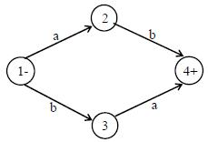
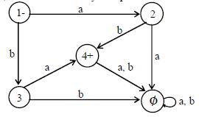
Example
Consider the following NFA
Using the method discussed earlier, the above NFA may be equivalent to the following FA

Slide 42
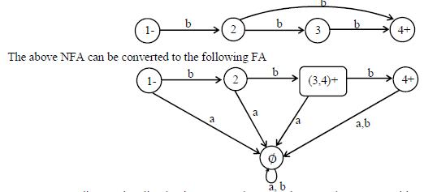
Example
A simple NFA that accepts the language of strings defined over
Σ = {a,b}, consists of bb and bbb

Slide 43
LINK
en.wikipedia.org/wiki/Kleene's_recursion_theorem
mathworld.wolfram.com/KleenesRecursionTheorem.html

